Slide 1
Rate of Road Accident
Project done by:
-Ayusha Bhola.
-Akshata Machal.
-Shrutika Chendake.

Slide 2
Contents:
1. Machine Learning.
2.Project Introduction.
3.Requirements.
4. Methodology.
5. Preferred Algorithm.
6.Conclusion & References.

Slide 3
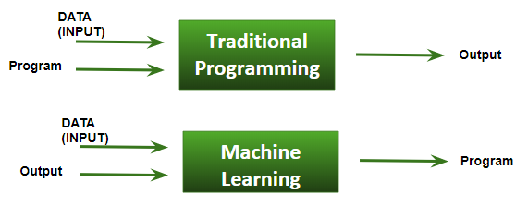
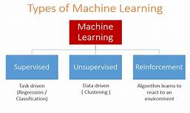
Machine Learning:
Machine Learning(ML) can be explained as automating and improving the learning process of computers based on their experiences without being actually programmed i.e. without any human assistance.
Classification of Machine Learning:
1.Supervised learning.
2.unsupervised learning.

Slide 4
Project Introduction-
There is a huge impact on the society due to traffic accidents where there is a great costs of fatalities and injuries.
In recent years, there is a increase in the researches attention to determine the significantly affect the severity of the drivers injuries which is caused due to the road accidents.
Accurate and comprehensive accident records are the basis of accident analysis. the effective use of accident records depends on some factors, like the accuracy of the data, record retention, and data analysis.
There is many approaches applied to this scenario to study this problem.

Slide 5
REQUIREMENTS :
Software: Anaconda – Jupyter.
Language: Python3
Modules Used:
-numpy
-pandas
-from pandas.tools.plotting import scatter_matrix
-import matplotlib.pyplot as plt

Slide 6
PROPOSED SYSTEM AND METHODOLOGY-
Models are created using accident data records which can help to understand the characteristics of many features like drivers behaviour, roadway conditions, light condition, weather conditions and so on.
This can help the users to compute the safety measures which is useful to avoid accidents.
It can be illustrated how statistical method based on directed graphs, by comparing two scenarios based on out-of-sample forecasts.
The model is performed to identify statistically significant factors which can be able to predict the probabilities of crashes and injury that can be used to perform a risk factor and reduce it.

Slide 7
Preferred Algorithm:
Multi-Linear Regression Algorithm
Multiple regression is the statistical procedure to predict the values of a response (dependent) variable from a collection of predictor (independent) variable values.
Polynomial Regression Algorithm
Polynomial Regression is a form of linear regression in which the relationship between the independent variable x and dependent variable y is modeled as an nth degree polynomial.
Decision Tree Regressor Algorithm
Decision Tree - Regression. Decision tree builds regression or classification models in the form of a tree structure. It breaks down a dataset into smaller and smaller subsets while at the same time an associated decision tree is incrementally developed.

Slide 8
Accuracy Score:
9.73%
66.77%
97.24%
Multi-Linear
Polynomial
Decision Tree
Not Preferred
Not Preferred
Preferred
(better results)

Slide 9
Conclusion and References:
Rate of the number of Casualties can be predicted using Machine Learning using Regression Type.
Decision Tree Algorithm gives better results as compared to Multi-Linear Regression Algorithm or Polynomial Regression Algorithm
Dataset References:- https://github.com/damianoc90/Road-accidents-analysis/blob/master/dataset.csv

